Slide 1
App Settings
Elvedin Selimoski

Slide 2
What are settings?
Setting screens
Implement settings
Default settings
Save and retrieve settings
Respond to changes in settings
Summaries for settings
Settings Activity template

Slide 3
What are app settings?
Users can set features and behaviors of app
Examples:
  Home location, defaults units of measurement
  Notification behavior for specific app
For values that change infrequently and are relevant to most users
If values change often, use options menu or nav drawer

Slide 4
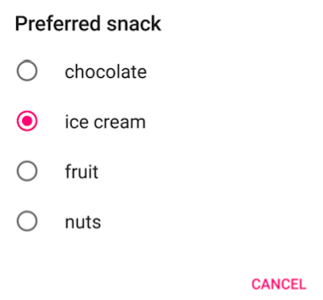
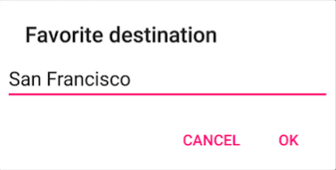

Example settings

Slide 5
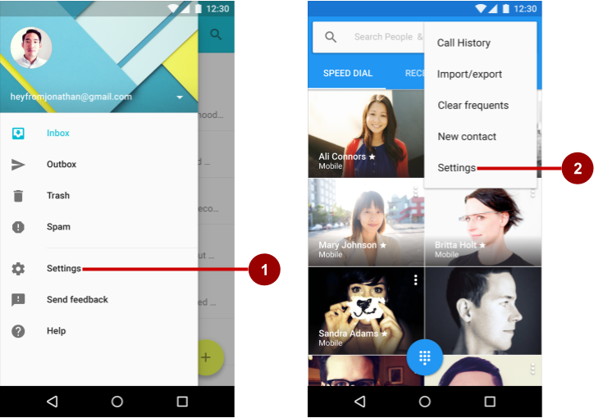
Accessing settings
Users access settings through:
Navigation drawer
Options menu

Slide 6
Setting screens
Elvedin Selimoski

Slide 7
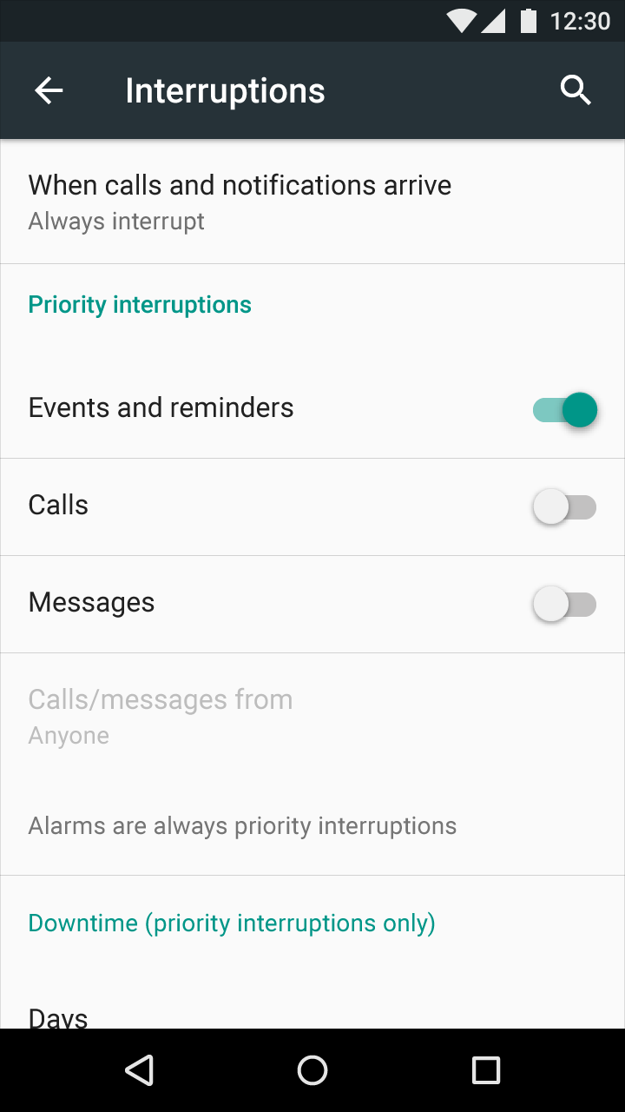
Organize your settings
Predictable, manageable number of options
7 or less: arrange according to priority with most important at top
7-15 settings: group related settings
under section dividers

Slide 8
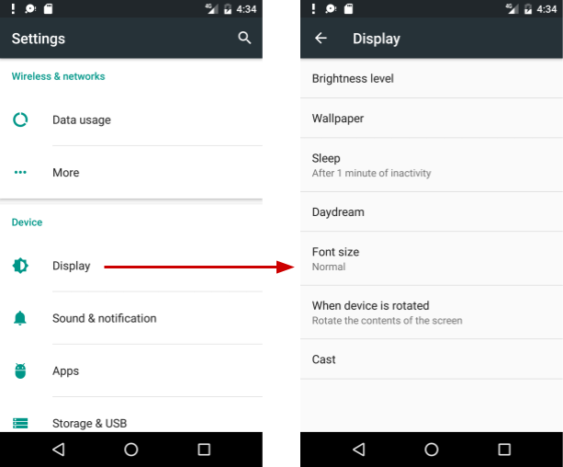
16+ Settings
Group into screens opened from main Settings screen

Slide 9
View versus Preference
Use Preference objects instead of View objects in your Settings screens
Design and edit Preference objects in the layout editor just like you do for View objects

Slide 10
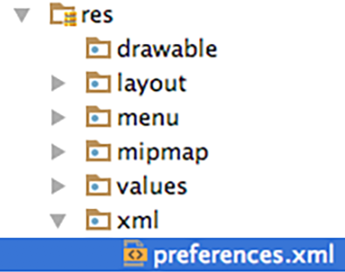
Define Settings in a Preference Screen
Define settings in a preferences screen
It is like a layout
define in:
res > xml > preferences.xml

Slide 11
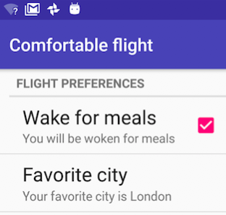
Preference Screen example
<PreferenceScreen>
<PreferenceCategory
android:title="Flight Preferences">
<CheckBoxPreference
android:title="Wake for meals"
... />
<EditTextPreference
android:title="Favorite city"
.../>
</PreferenceCategory>
</PreferenceScreen>

Slide 12

Every Preference must have a key
Every preference must have a key
Android uses the key to save the setting value
<EditTextPreference
android:title="Favorite city"
android:key="fav_city"
… />

Slide 13
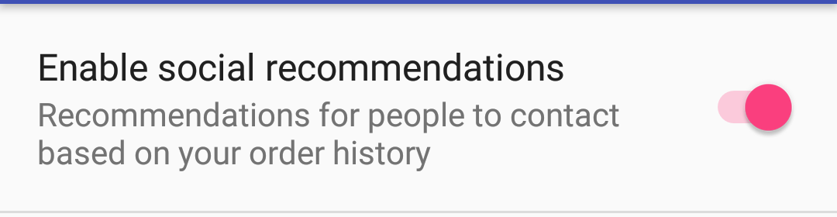
SwitchPreference
<PreferenceScreen xmlns:android="http://schemas.android.com/apk/res/android">
<SwitchPreference
android:defaultValue="true"
android:title="@string/pref_title_social"
android:key="switch"
android:summary="@string/pref_sum_social" />
</PreferenceScreen>

Slide 14
SwitchPreference attributes
android:defaultValue—true by default
android:summary—text underneath setting, for some settings, should change to reflect value
android:title—title/name
android:key—key for storing value in SharedPreferences

Slide 15
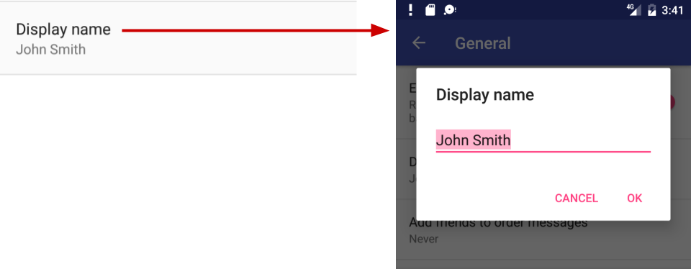
EditTextPreference
<EditTextPreference
android:capitalize="words"
android:inputType="textCapWords"
android:key="user_display_name"
android:maxLines="1"
android:defaultValue="@string/pref_default_display_name"
android:title="@string/pref_title_display_name" />

Slide 16
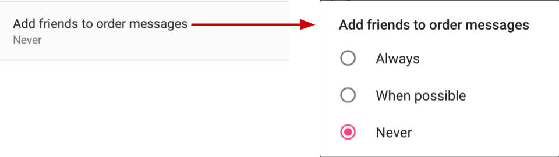
ListPreference
<ListPreference
android:defaultValue="-1"
android:key="add_friends_key"
android:entries="@array/pref_example_list_titles"
android:entryValues="@array/pref_example_list_values"
android:title="@string/pref_title_add_friends_to_messages" />

Slide 17
ListPreference
Default value of -1 for no choice
android:entries—Array of labels for radio buttons
android:entryValues —Array of values radio button

Slide 18
Preference class
Preference class provides View for each kind of setting
associates View with SharedPreferences interface to store/retrieve the preference data
Uses key in the Preference to store the setting value

Slide 19
Preference subclasses
CheckBoxPreference—list item that shows a checkbox
ListPreference—opens a dialog with a list of radio buttons
SwitchPreference—two-state toggleable option
EditTextPreference—that opens a dialog with an EditText
RingtonePreference—lets user to choose a ringtone

Slide 20
Classes for grouping
PreferenceScreen
  root of a Preference layout hierarchy
  at the top of each screen of settings
PreferenceGroup
  for a group of settings (Preference objects).
PreferenceCategory
  title above a group as a section divider

Slide 21
Implement settings
Elvedin Selimoski

Slide 22
Settings UI uses fragments
Use an Activity with a Fragment to display the Settings screen
Use specialized Activity and Fragment subclasses that handle the work of saving settings

Slide 23
Activities and fragments for settings
Lesson focusses on this!
Android 3.0 and newer:
  AppCompatActivity with PreferenceFragmentCompat
  OR use Activity with PreferenceFragment
Android older than 3.0 (API level 10 and lower):
  build a special settings activity as an extension of the PreferenceActivity class (use the template!)

Slide 24
Steps to implement Settings
For AppCompatActivity with PreferenceFragmentCompat
Create the preferences screen
Create an Activity for the settings
Create a Fragment for the settings
Add the preferenceTheme to the AppTheme
Add code to invoke Settings UI

Slide 25
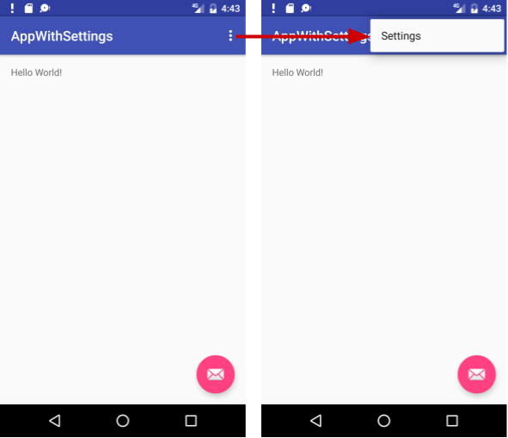
Basic Activity template
Basic Activity template
Includes options menu
Settings menu item provided for options menu

Slide 26
Create a Settings Activity subclass
Extends AppCompatActivity
in onCreate() display the settings Fragment:
getSupportFragmentManager()
.beginTransaction()
.replace(android.R.id.content,
new MySettingsFragment())
.commit();

Slide 27
Settings Activity example
public class MySettingsActivity extends AppCompatActivity {
@Override
protected void onCreate(Bundle savedInstanceState) {
super.onCreate(savedInstanceState);
getSupportFragmentManager().beginTransaction()
.replace(android.R.id.content, new MySettingsFragment())
.commit();
}
}
This is the whole class!

Slide 28
Create a Settings Fragment subclass
Extends PreferenceFragmentCompat
Implement methods:
  onCreatePreferences() displays the settings
  setOnPreferenceChangeListener() handles any changes that need to happen when the user changes a preference (optional)

Slide 29
PreferenceFragment
public class MySettingsFragment
extends PreferenceFragmentCompat { …}
Blank fragments include onCreateView() by default
Replace onCreateView() with onCreatePreferences() because this fragment displays a preferences screen

Slide 30
Settings Fragment example
public class MySettingsFragment extends PreferenceFragmentCompat {
@Override
public void onCreatePreferences(Bundle savedInstanceState,
String rootKey) {
setPreferencesFromResource(R.xml.preferences, rootKey);
}
}

Slide 31
Add PreferenceTheme to app's theme
If using PreferenceFragmentCompat, set preferenceTheme in styles.xml:
<style name="AppTheme" parent="...">
...
<item name="preferenceTheme">
@style/PreferenceThemeOverlay
</item>
…
</style>

Slide 32
Invoke Settings UI
Send the Intent to start the Settings Activity:
From Options menu, update onOptionItemsSelected()
From Navigation drawer, update onItemClick() on the OnItemClickListener given to setOnItemClickListener

Slide 33
Default Settings
Elvedin Selimoski

Slide 34
Default settings
Set default to value most users would choose
  All contacts
Use less battery power
  Bluetooth is off until the user turns it on
Least risk to security and data loss
  Archive rather than delete messages
Interrupt only when important
  When calls and notifications arrive

Slide 35
Set default values
Use android:defaultValue in Preference view in xml:
<EditTextPreference
android:defaultValue="London"
… />
In onCreate() of MainActivity, save default values.

Slide 36
Save default values in shared preferences
In onCreate() of MainActivity
PreferenceManager.setDefaultValues(
this, R.xml.preferences, false);
App context, such as this
Resource ID of XML resource file with settings
false only calls method the first time the app starts

Slide 37
Save and retrieve settings
Elvedin Selimoski

Slide 38
Saving setting values
No need to write code to save settings!
If you use specialized Preference Activity and Fragment, Android automatically saves setting values in shared preferences

Slide 39
Get settings from shared preferences
In your code, get settings from default shared preferences
Use key as specified in preference view in xml
SharedPreferences sharedPref = PreferenceManager.getDefaultSharedPreferences(this);
String destinationPref =
sharedPref.getString("fav_city", "Jamaica");

Slide 40
Get settings values from shared preferences
In preference definition in xml:
<EditTextPreference
android:defaultValue="London"
android:key="fav_city" />
In code, get fav_city setting:
String destinationPref =
sharedPref.getString("fav_city", "Jamaica");
default setting value
is different than
default value returned by pref.getString() if key is not found in shared prefs

Slide 41
Respond to changes in settings
Elvedin Selimoski

Slide 42
Listening to changes
Display related follow-up settings
Disable or enable related settings
Change the summary to reflect current choice
Act on the setting
For example, if the setting changes the screen background, then change the background

Slide 43
Listen for changes to settings
Define setOnPreferenceChangeListener()
in onCreatePreferences() in the Settings Fragment

Slide 44
onCreatePreferences() example
@Override
public void onCreatePreferences(Bundle savedInstanceState,
String rootKey) {
setPreferencesFromResource(R.xml.preferences, rootKey);
ListPreference colorPref =
(ListPreference) findPreference("color_pref");
colorPref.setOnPreferenceChangeListener(
// see next slide
// ...);
}

Slide 45
onPreferenceChangeListener() example
Example: change background color when setting changes
colorPref.setOnPreferenceChangeListener(
new Preference.OnPreferenceChangeListener(){
@Override
public boolean onPreferenceChange(
Preference preference, Object newValue){
setMyBackgroundColor(newValue);
return true;
}
});

Slide 46
Summaries for settings
Elvedin Selimoski

Slide 47
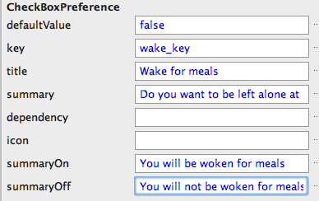

Summaries for true/false values
Set attributes to define conditional summaries for preferences that have true/false values

Slide 48
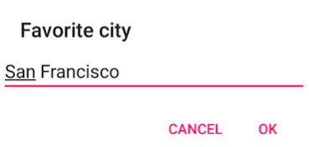

Summaries for other settings
For settings that have values other than true/false, update the summary when the setting value changes
Set the summary in
onPreferenceChangeListener()

Slide 49
Set summary example
EditTextPreference cityPref = (EditTextPreference)
findPreference("fav_city");
cityPref.setOnPreferenceChangeListener(
new Preference.OnPreferenceChangeListener(){
@Override
public boolean onPreferenceChange(Preference pref, Object value){
String city = value.toString();
pref.setSummary("Your favorite city is " + city);
return true;
}
});

Slide 50
Activity Template
Elvedin Selimoski

Slide 51
More complex?
For anything more complex
?
use the Settings Activity template!

Slide 52
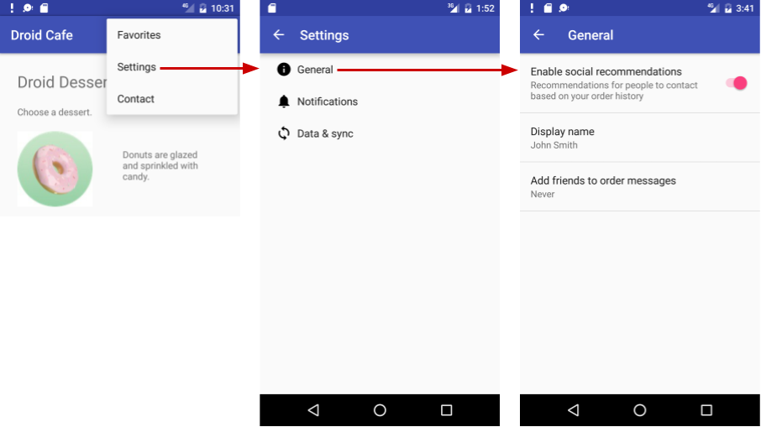
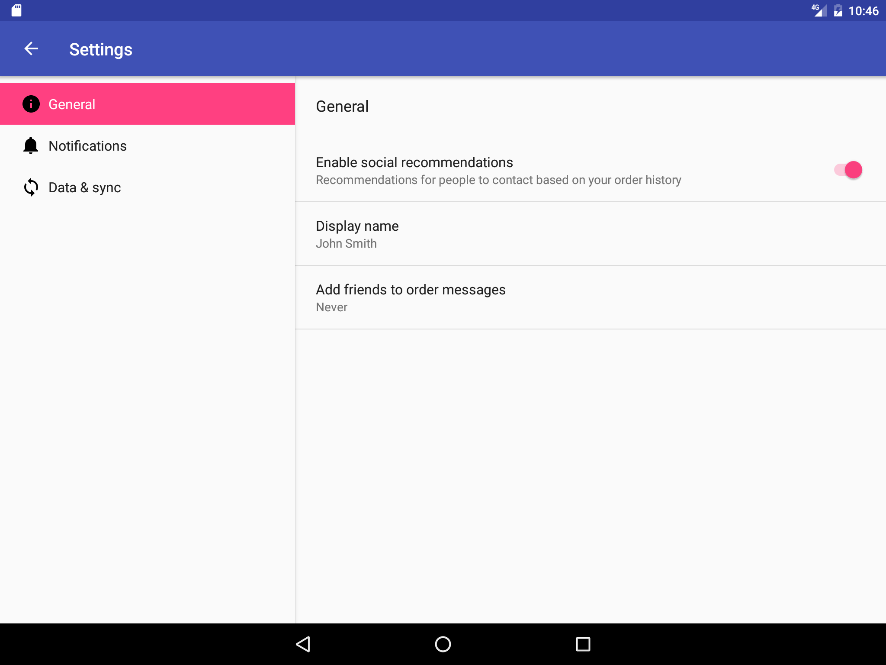
Settings Activity template
Complex Settings
Backwards compatibility
Customize pre-populated settings
Adaptive layout for phones and tablets
Phone
Tablet

Slide 53
Learn more
Elvedin Selimoski

Slide 54
What are app settings?
Android Studio User Guide
Settings (coding)
Preference class
PreferenceFragment
Fragment
SharedPreferences
Saving Key-Value Sets
Settings (design)

Slide 55
END

